Slide 1

FBI
partner
development
1990 !41.CHECKPOINT CHARLIE, !PRESIDENT REAGEAN
INT.IPX; 1D8723
2005 INT.IPX (roth.ibm.daimler) 2010
HOMICDIE:GHOST(wake) HOMCI:ITALIEN:20
2005 PENTAOGN.roth.ibm.daimler.deere Middlefied Road, Moutain View, California
Blue Wedding Suite HOMCIE:CLEANER Latham Street, Moutain View
Assuemed; VIRIGINA.google
KING
Sky is grey
Gov.Schw(unimog)
WWI(Thomas-is-dieter).Gorbache(micheala)
ibm.daimler
ibm.daimler

Slide 2
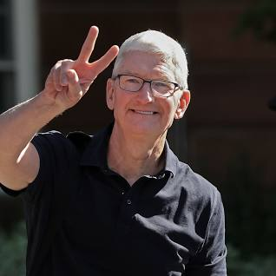
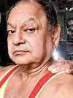

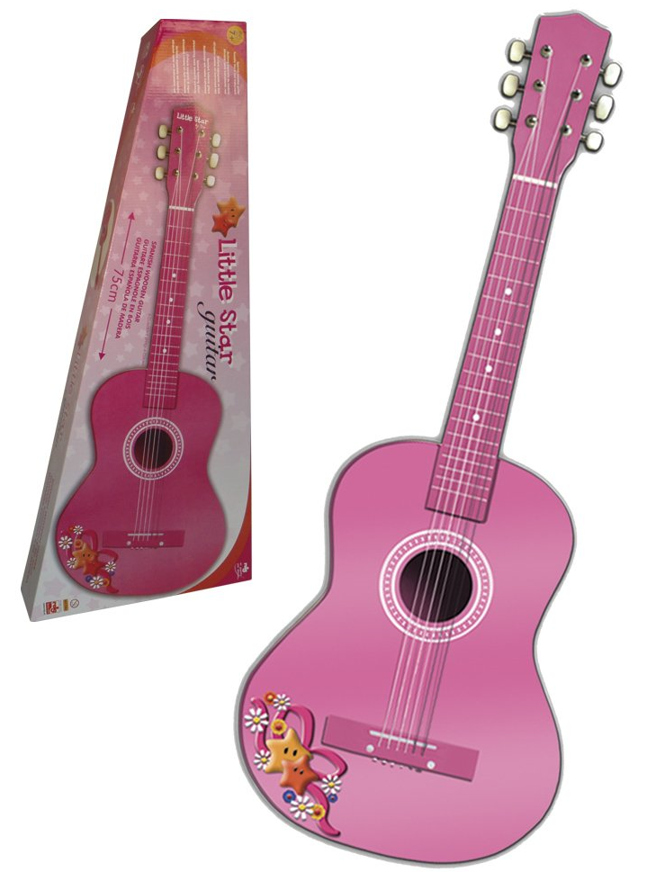
FBI
partner
development
2015 May
FBI:KIDNAPPING.v2
HOMCIDE:2Y, HOMCIDE:7Y
Birds Eye View
HOMCE:JEUSE:HOMCES:TANVEST
Moving services
!fag silent treatment.avg(nokia)
Tim cook, Steve Meiers;
Cypress Blvd, Oakley,
California

Slide 3
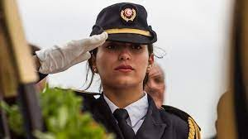

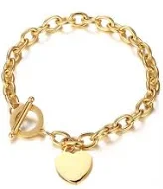
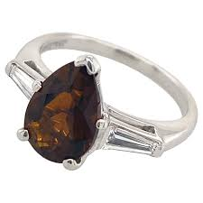
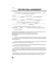
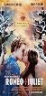

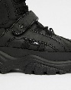
FBI
partner
development
God.Tunisian
.Parent.appel.damielr.marx(hellsangels).security
1997 September
G.MAINSTREET(SALES)
Move Out
Apple.davidon.marx(hellsangle)
Tom hanks completed
1980-1997
Id.parent: 500lbs/100lbs
130,000 DM
JFK.BULLET.24
0.01 fine ing/queen/jobs/jbos/meiers/meiers/meiers
41.JFK.MATHE.mAINSTREET((move the shoes
VP GERMANY.!JFK(Goethe,marco gheoh(heger a/e a/o))
J5
O
ATOMCLICK(HOMCIDE:AUSLAENDER.War in Yuglsalvia).Pope.!St. Ansleom.VIRNIG.AMRY(dr rice).son.marx(2pac)
not there; father

Slide 4
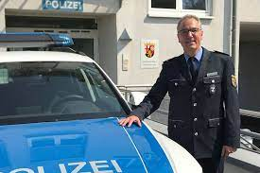
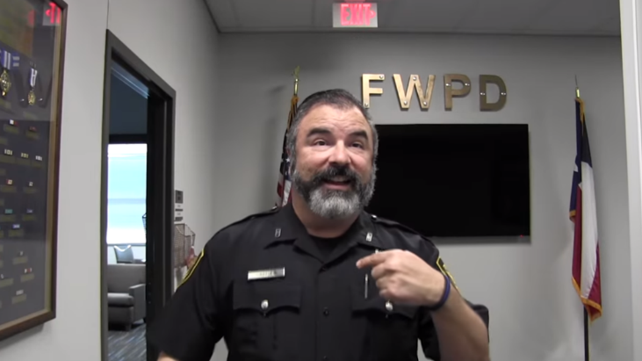
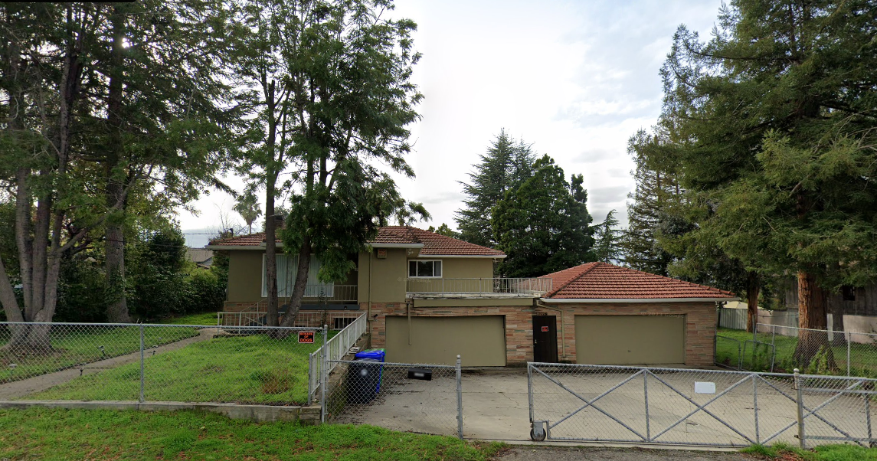
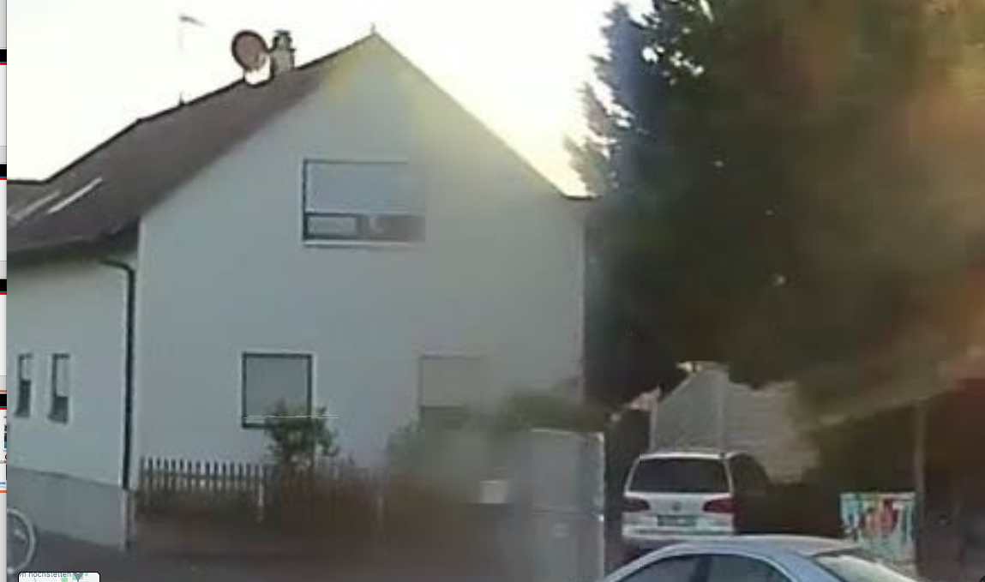
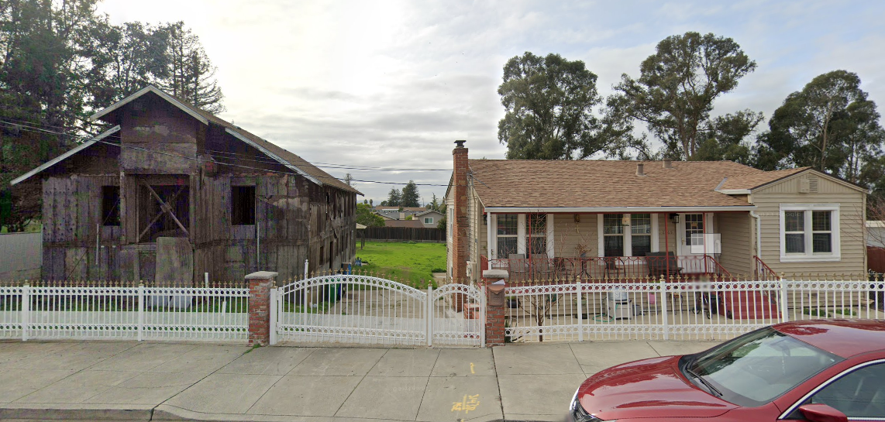
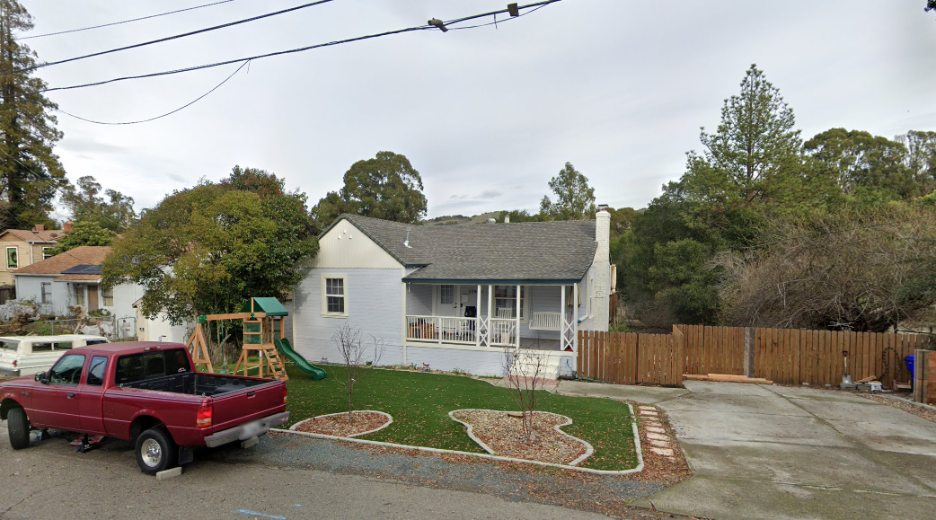
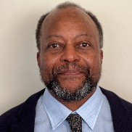

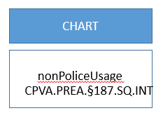
FBI
partner
development
1997 December
HOMICDIE:KYSTAL.lingusti(slanded driveway entry)
d
(“Move out”)
HOMIE:LUX.lsnti(shot in windows crysler)
MAINSTREET(haupstrasse
PAUL, 17(IPX[])
9-1-1
Call
CHART
ATOMCLOCK
nonPoliceUsage
CPVA.PREA.§187.SQ.INT
CPVA.PREA.§187.SQ.INT
Petersson
Church”Black”
Visa
Otis Morgan
Morgan Freman
SQ.INT.IPX.FBI.INTESTING(chales manson)
Hells angele sonny berger, carbolaouge
PENTGONA.BASE.MANNHEIM.COLEMAN
[x] no
[x] no
!41.PREA

Slide 5
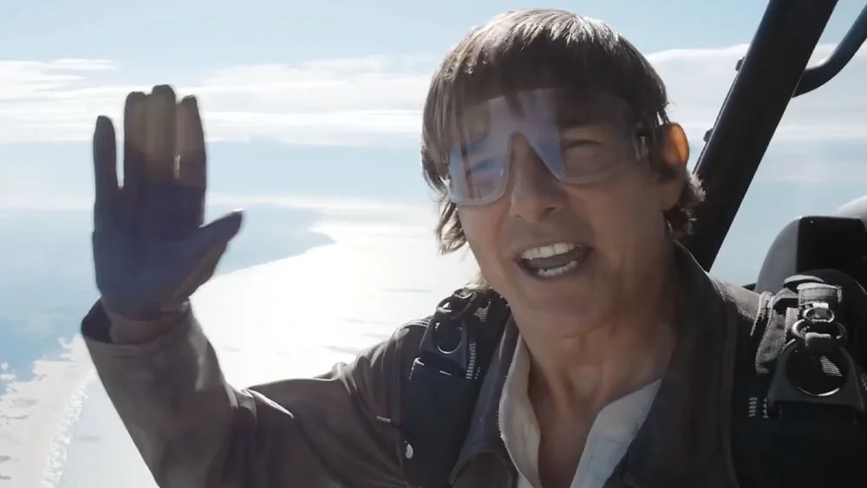
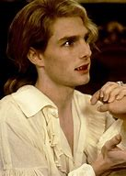
FBI
partner
development
Stanford
Angel Merkel
Michekal Gorbachev
PENTAGON.VIRGINA.MARY
Achim, Arim, Dr. Profl Joachim Zahn, Daimler Ag
- Immate studies langues in 1994, transfer soul
1995 GAS(Rudolf-diesel-strasse)
Gorbache(dell.cleint.uhse.(beathe)
9-1-1 Flights
HOMCE:LUX:COINTWON(brucsal,munsezshiem)
Daimler Ag
Dr. Dieter Zehce
TUI/L’t Meiers Weltreisen,
Deutsch Reeisbuerk Karluerhe
Adolpf Hitler/Eva Bran-Vera Braun
Batman?
Beate: - Keih leget dies on set

Slide 6

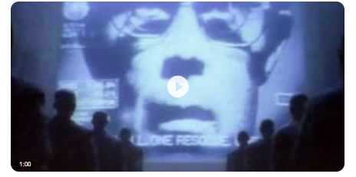
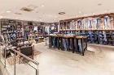


FBI
partner
development
1997
HOICME:LUX(gheoh(eiscaking, docs) Patatu shoes
docs
Seriel Killer 1 and 2 not 3
Note: Group of Seriel Killers
Recylig.pms.”silver surfer”: soul
WWI(Jerome).K-TOWN
!fag.boyfriend HOMCIE:TRANVETITE(IPX hard.41) HOMICDIE:JESUS
MATHERE: they killed him: 41.ASSAULT.STALKING.WWI.HOIMCE:JESUE[apple]
41.JFK.MATHE.mAINSTREET((move the shoes
VP GERMANY.!JFK(Goethe,marco gheoh(heger a/e a/o))
J5
O

Slide 7
FBI
partner
development
2010 !PRIVATE.41
PUBLIC
Grobachev(Visa France )
nonPoliceContentItems
!AVAILBILITY.
!IN
nonPoliceContentItems
INTERNET PAYMENTS
FACEBOOK
0.1 click I want to show
0.1 runner gheoho(tyson,mike, visa.planspna)
0.1 fast do that anywy
PUBLIC risk STANFORD:visa McCarty visa risk,pmp
SQ.PREA.187 (keepalive)

Slide 8
FBI
partner
development

